Slide 1
Materials Selection for Engineering Design
https://www.youtube.com/watch?v=naAyKLw6pNU

Slide 2
Materials Selection
The designer of any product, must get involved with material selection.
Only occasionally will the exact grade of material be specified by the customer.
Even then the designer must understand the material to be able to design the product.

Slide 3
Objectives

Slide 4
Decisions, decisions!
So many materials, so much information.
How do we decide?
How do we begin to choose?
First we need to look at the function of the product – product analysis

Slide 5
Product Analysis
Just what it says – analyse the product!
What does it do?
How does it do it?
Where does it do it?
Who uses it?
What should it cost?

Slide 6
Case Study – a bike
What is the function of a bike – obvious?
How does the function depend on the type of bike?
  Racing
  Touring
  Mountain bike
  Commuter
  Childs

Slide 7
Case Study – a bike (2)
How is it made to be easily maintained?
What should it look like (colours etc.)?
What should it cost?
How has it been made comfortable to ride?
How do the mechanical parts work and interact?

Slide 8
Component or system?
1st problem is…….
Is it one component or a system of components working together?
A spanner is a component, a cordless screwdriver is a system.

Slide 9
System Analysis
When we analyse a system we need to break the system down into individual components and then analyse each one.

Slide 10
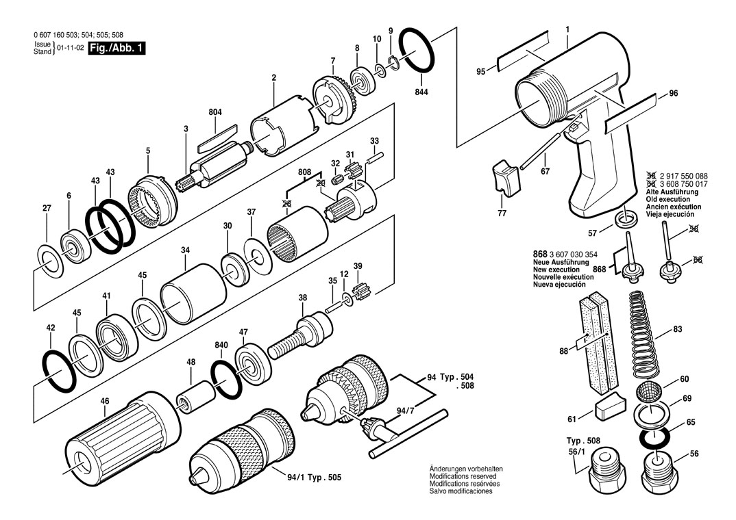
Cordless screwdriver

Slide 11
System Analysis – the bike
The bike breaks down (we hope not!) into various parts:
Frame
Forks
Wheels
Saddle
Etc.

Slide 12
System Analysis – the bike (2)
We now need to look at the following for each part:
Requirements (mechanical, ergonomic, aesthetic etc.)
Function
How many are going to be made?
What manufacturing methods are we going to use?

Slide 13
Manufacturing
Oh No!
We have to actually make it!
This is a key question which has a massive influence on materials selection.
e.g. The frame, what materials could we use?

Slide 14
Frame Materials
Steel –
Strong, stiff, heavy, but cheap
Aluminium –
weaker, lighter, more expensive than steel
Composite (CFRP) –
strong, stiff, very light, but expensive to buy and to fabricate

Slide 15
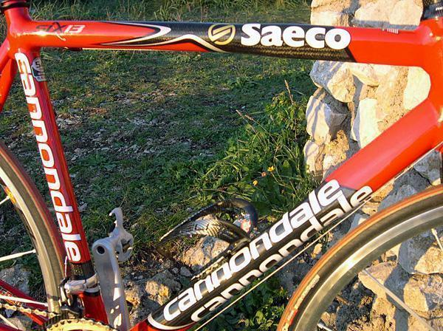
Bike Frame

Slide 16
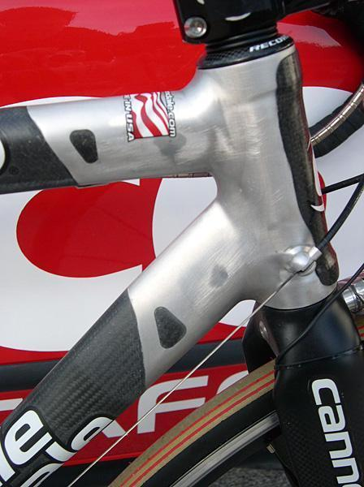
Frame Design Detail

Slide 17
What Properties?
Mechanical –
Strength, modulus etc.
Physical –
Density, melting point.
Electrical –
Conductivity, resistivity.
Aesthetic –
Appearance, texture, colour
Processability –
Ductility, mouldability
And last, but not least……….
Cost, cost, cost!

Slide 18
Where do I find the data?
Textbooks
Databooks
Manufacturer’s literature
Internet Sites

Slide 19
Textbooks
Good for general information
Some have tables of properties
Not good for detailed specifications and properties.
A useful first point of call

Slide 20
Databooks
One of the quickest sources of detailed information.
Usually contain grades and specifications as well as properties.
Small and perfectly formed – pocketbooks
Easy to navigate around

Slide 21
Manufacturer’s literature
Variable in quality and usefulness.
Often only cover their products.
Usually do not compare materials.
Can be biased.
Good for final selection before ordering.

Slide 22
Internet Sites
Can be a real minefield.
Lots of poorly presented information.
Google searches bring up lots of rubbish.
Hard to find technical information.
Best to use non-commercial sites.

Slide 23
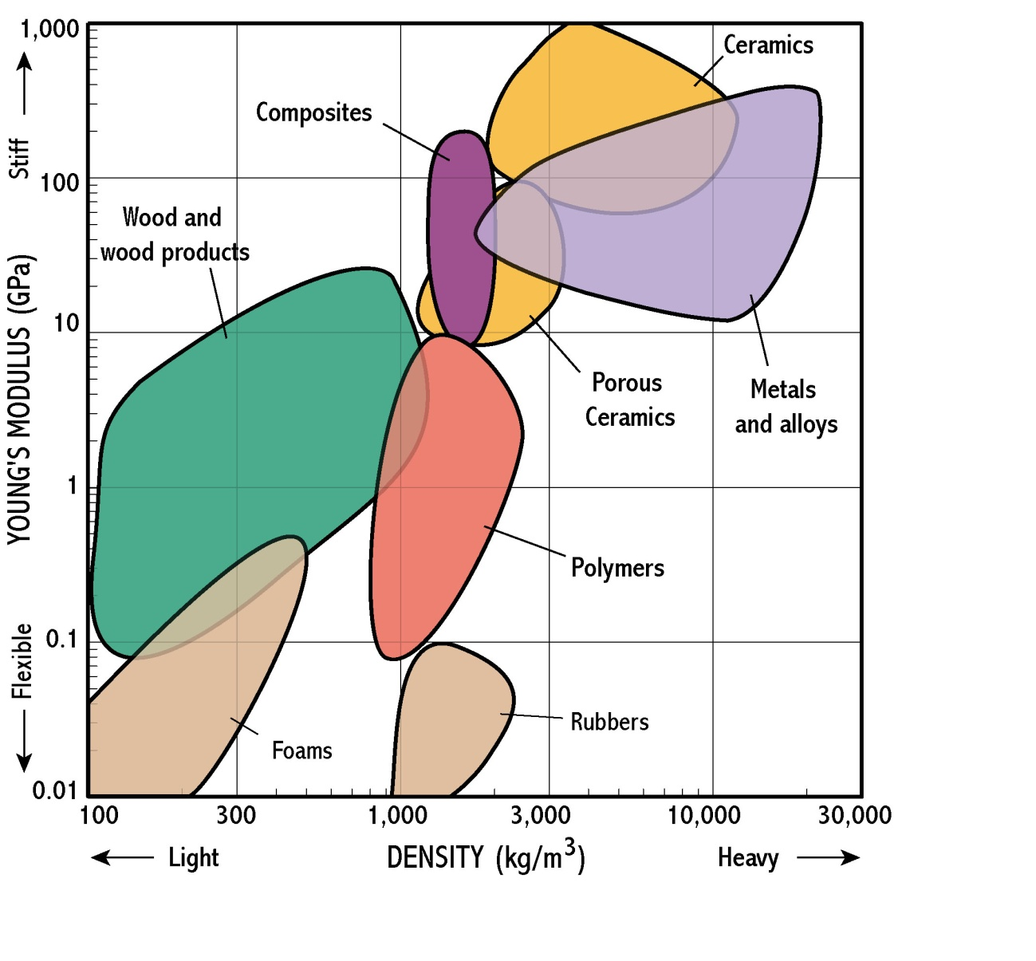
Materials Selection Charts

Slide 24
Materials Selection Charts
Allow easy visualisation of properties
Show lots of different materials
Can be ‘drilled down’ to specifics
Show balances of properties
e.g. strength v cost
Ideal for a first ‘rough cut’ selection

Slide 25
Summary
Think about the design from ergonomic and functional viewpoint.
Decide on the materials to be used.
Choose a suitable process that is also economic
Don’t forget the ……………

Slide 26

Bigger Picture
Is the product performance driven or cost driven?
This makes a huge difference when choosing materials.

Slide 27

Manufacturing Process
Although we usually choose materials first sometimes it is the shape and process which is the limiting factor.

