Slide 1
Metallic Bonds (Metals)

Slide 2
Metal.
Above their melting point, metals are liquids, and their atoms are randomly arranged and relatively free to move. However, when cooled below their melting point, metals rearrange to form ordered, crystalline structures.

Slide 3
Crystalline Structures.
Melting is the process most often used to form an aggregate of atoms.
When the temperature of a melt is lowered to a certain point, the liquid will form either a crystalline solid or and amorphous solid.
Crystalline structures are found in metals.

Slide 4
Unit Cell Structures.
Body Centre Cubic. BCC
Face Centre Cubic. FCC
Hexagonal Close Packed. HCP

Slide 5
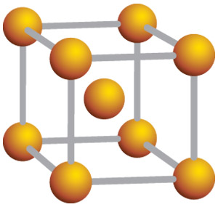
Body Centre Cubic.
The body-centred cubic unit cell has atoms at each of the eight corners of a cube plus one atom in the centre of the cube.

Slide 6
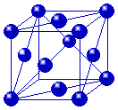
Face Centre Cubic.
The face centred cubic structure has atoms located at each of the corners and the centres of all the cubic faces.

Slide 7
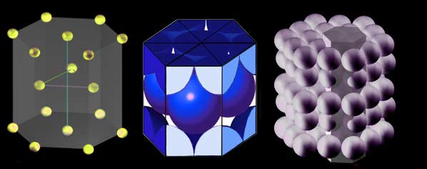
Hexagonal Close Packed.
The hexagonal structure of alternating layers is shifted so its atoms are aligned to the gaps of the preceding layer.

Slide 8
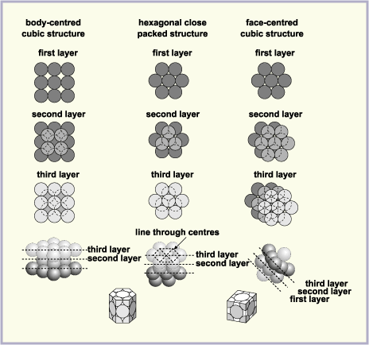
Common Crystal Structures.

Slide 9
Metals & Structures.
MetalCrystal Structure
Aluminium FCC
Cadmium HCP
Chromium BCC
Cobalt HCP
Copper FCC
Gold FCC
Iron (Alpha)BCC
Lead FCC
Magnesium HCP
Molybdenum BCC
Nickel FCC
Platinum FCC
Silver FCC
Tantalum BCC
Titanium (Alpha)HCP
Tungsten BCC
Zinc HCP

Slide 10
Crystalline Structures.
The atoms in crystals are packed together in a regular, repeating pattern, known as the space lattice: solids with no such order are said to be ‘amorphous’. The unit cell is the simplest geometric figure which represents the grouping of particles: a crystal consists of a large number of these unit cells stacked together.

Slide 11
Crystalline Structures.
There are many other crystal structures found in metals, but we tend to concentrate on these particular close-packed structures because they are the crystal forms found in the metals used for engineering purposes. This is because close-packed structures are linked with ductility, where materials under load start stretching before they break. This movement can be used to give early warning of potential failure, and is to be preferred to the alternative of ‘brittle fracture’, where there is no similar indication.

Slide 12
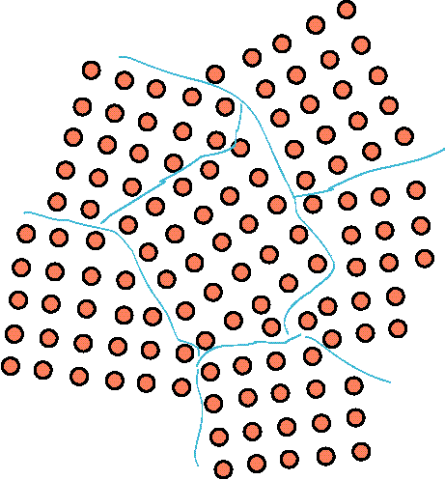
Grain Structure.
Grain structure is generally not visible without etching with a chemical which preferentially attacks the grain boundaries.

Slide 13
Grain Boundaries.
A Grain Boundary is a general planar defect that separates regions of different crystalline orientation.
The atoms in the grain boundary will not be in perfect crystalline arrangement.
Grain boundaries are usually the result of uneven growth when the solid is crystallising.

Slide 14
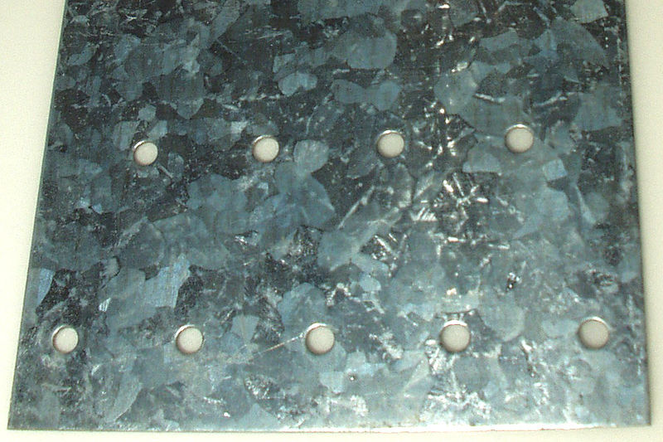
Galvanised Finish (Showing Grain Crystallisation)

Slide 15
Grain Formation.
Cooling of a liquid metal
Crystallisation occurs around small nuclei, which may be impurity particles. The first crystals have the crystal shape into which the metal would naturally solidify, for example face-centred cubic in the case of copper. However, as the crystal grows, it tends to develop spikes and its shape changes into a tree-like form called a dendrite.

Slide 16
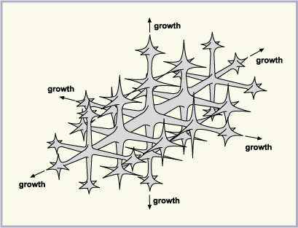
Grain Growth.
Growth of a Dendrite.

Slide 17
Dendritic Expansion or Growth
As the dendrite grows, the spaces between its arms fill up. Outward growth stops when growing arms meet others. Eventually the entire liquid solidifies, and there is little trace of the original dendritic structure, only the grain into which the dendrites have grown.

Slide 18
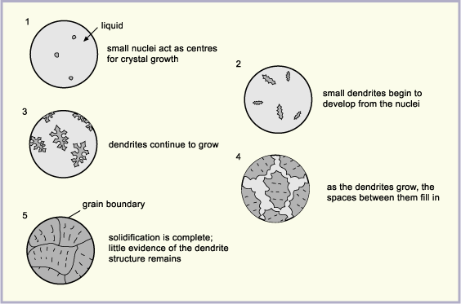
Solidification of Metal.

Slide 19
Grain Structure Influence.
Physical properties of metals not only depend on composition but are also strongly linked to microstructure and especially to grain structure.
Parameters such as mechanical properties vary with the size and shape of the grains.
Like most of the metallurgical characteristics, grain structure is first determined during solidification in the casting process.
Subsequent mechanical and thermal treatment can modify these grains.

Slide 20
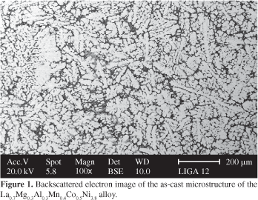
Examples of Grain Structure.

Slide 21
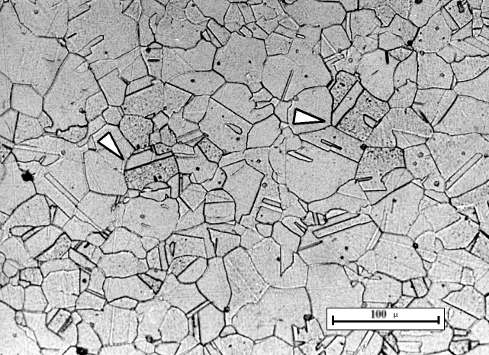
Grain Structure.

Slide 22
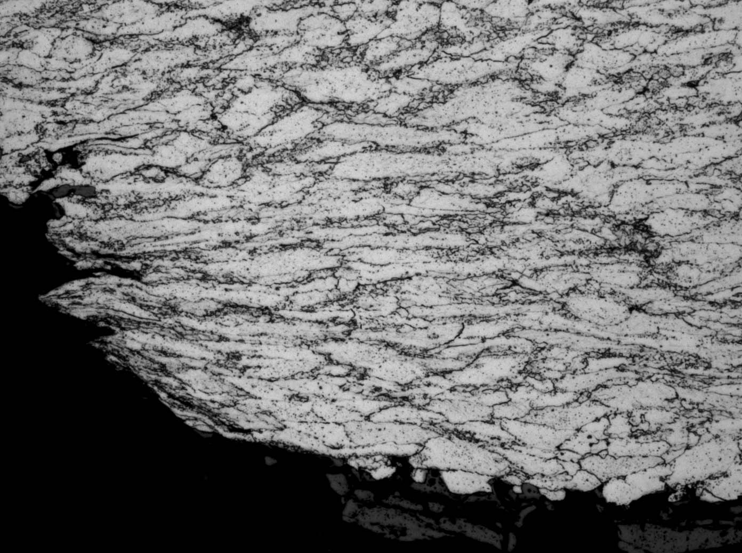
Grain Structure.

