Slide 1
Formation & Phases of Steel

Slide 2
What is Steel?
Steel is made by dissolving carbon into iron.
Pure iron melts at an extremely high temperature, 1540 °.
At such temperatures, carbon readily dissolves into the molten iron, generating a liquid solution.
When the liquid solution solidifies, it generates a solid solution.

Slide 3
Steel.
Carbon (C) atoms are dissolved into the solid iron.
The individual carbon atoms lie in the holes between the iron atoms of the crystalline grains .

Slide 4
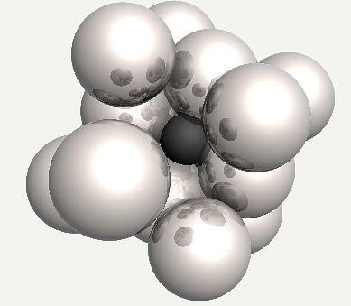
Carbon Atoms Laying Between.

Slide 5
Carbon Content.
As the metal cools, different phases occur within the structure.
Dependant on temperature and carbon content.
The carbon content dictates the property of steel. eg: Low, Medium or High.
Soft, Half-Hard, Hard.
Malleable, Balances Ductility with Strength and good Wear Resistance, Very hard & strong with resistance to scratching and indentation.

Slide 6
Carbon Content.
Always expressed as a percentage.
Low carbon steel contains approximately 0.05–0.15% carbon.
Medium carbon steel approximately 0.30–0.8% carbon content.
High carbon steels approximately 0.8–0.99% carbon content.
Ultra hard carbon steels approximately 1.0–2.0% carbon content.
Anything over 2.0% classified as Cast Iron.

Slide 7
Phases.
As the steel cools the material undergoes different changes or phases.
These phases alter in accordance with heat and carbon content.
In other words different phases occur at different temperatures dependant on the amount of carbon contained within.
These can be plotted using a standard diagram.

Slide 8
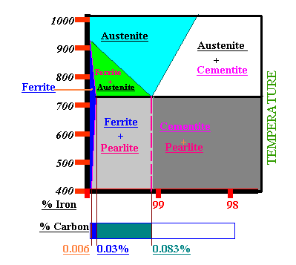
Iron Carbon Equilibrium Phase Diagram.

Slide 9
Eutectoid Point.
A eutectic or eutectic mixture is a mixture of two phases at a composition that has the lowest melting point.
This where the phases simultaneously crystallise from molten structure at this temperature.

Slide 10
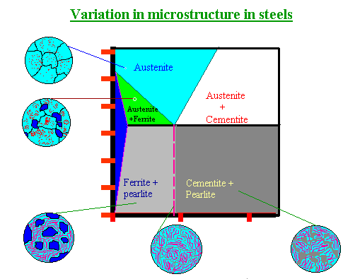
Variation in micro structure in Steels.

Slide 11
Phases as listed.
Austenite.
Austenite + Ferrite.
Austenite + Cementite.
Austenite +Pearlite.
Cementite + Pearlite.

Slide 12
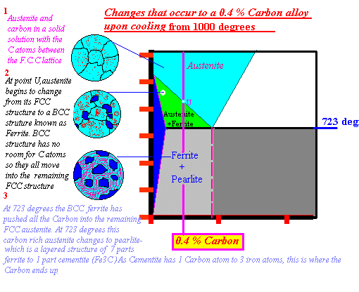
0.4% Carbon Content Steel.

Slide 13
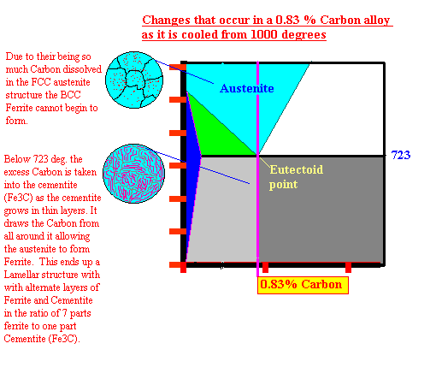
0.83% Carbon Content.

Slide 14
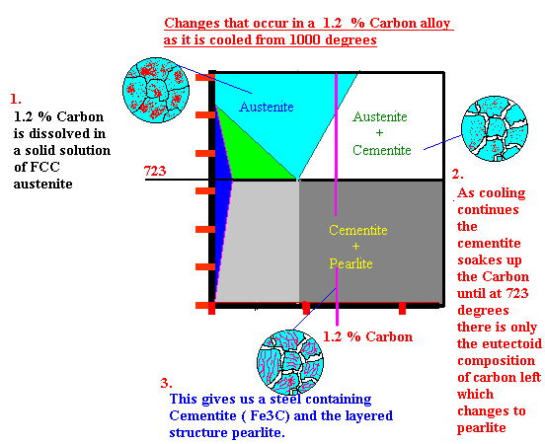
1.2% Carbon Content.

Slide 15
Ferrite Phase.
This is a weak solution of carbon in body centre cubic crystals of iron.
Maximum 0.03% carbon in solid solution at 723 Deg C
This falls to 0.006% at room temperature.
Ferrite is very soft, ductile and low strength.
For all practical purposes it maybe considered as pure iron.

Slide 16
Austenite Phase.
Much more concentrated solid solution of carbon in iron than Ferrite.
Austenite is formed when the carbon dissolves in FCC crystals of iron in the solid state.
Maximum amount of carbon which can be held in solution is 1.7% at 1150 Deg. C

Slide 17
Cementite.
An excess of carbon combines with iron to form iron carbide.
Each molecule of iron carbide contains three atoms of iron chemically combined with one atom of carbon.
This applies up to 1.7% carbon at room temperature, beyond which excess carbon is precipitated out as flakes of graphite.

Slide 18
Pearlite.
As the temperature drops to 723 Deg C and the carbon content = 0.83%.
The crystals precipitated out have a lamellar structure.
Consisting of alternate layers of ferrite and cementite
This structure is referred to as Pearlite.

